Slide 1
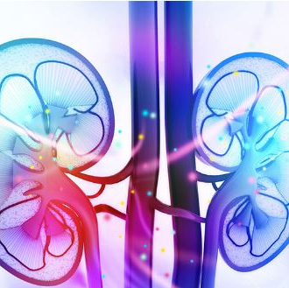
Early Detection of chronic kidney disease
Using Machine learning

Slide 2
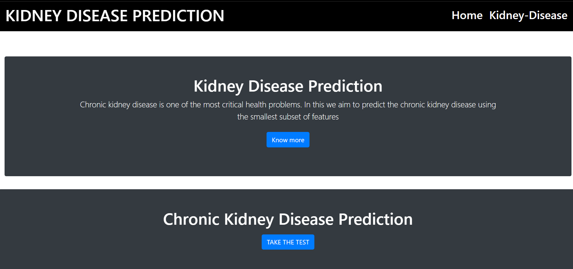
HOME PAGE
User can make use of this button take a test to detect the chronic kidney disease anywhere anytime easily. Know more button help to know more about a disease.

Slide 3
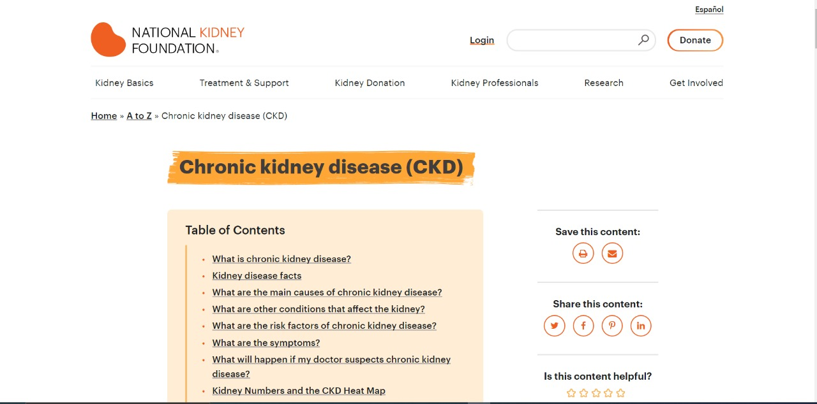
An External link which helps an user or a person to understand more clearly about this chronic kidney disease.

Slide 4
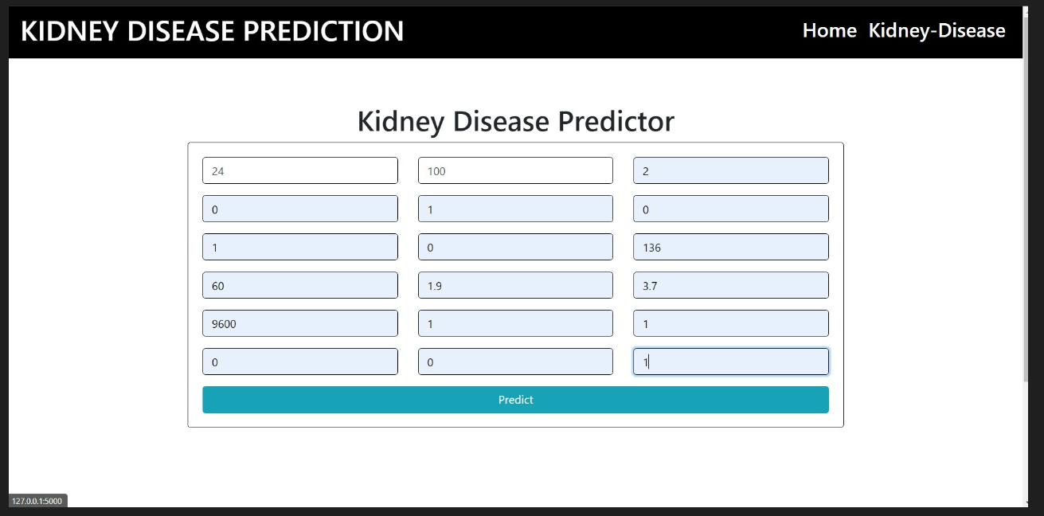
PREDICTION PAGE
Once when the user click the button the the test he/she will be redirected to the prediction page which allows user to type in all the required fields in order to predict the presence of disease.

Slide 5

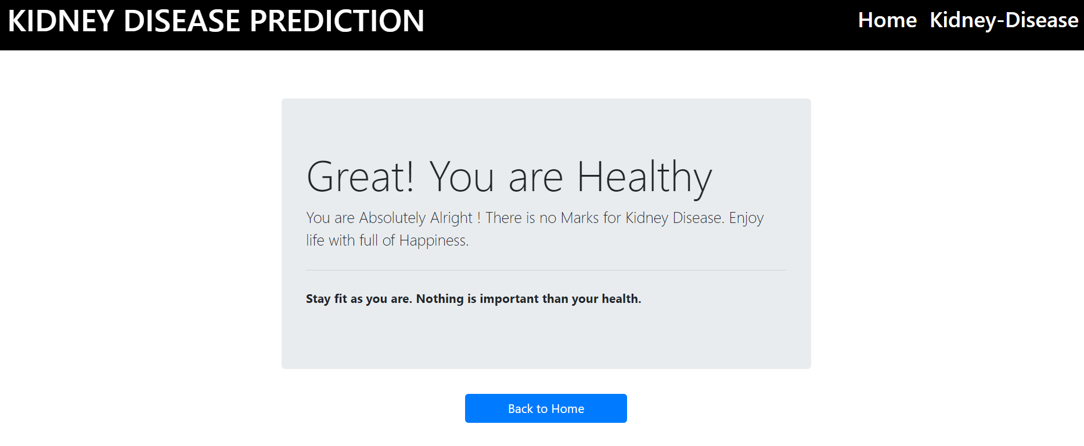
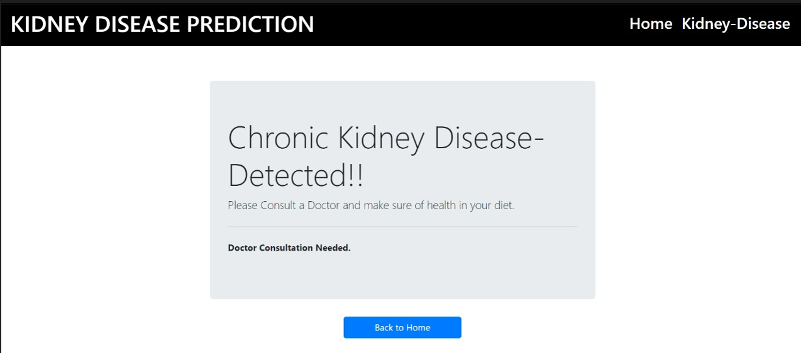


RESULT PAGE
POSITIVE
NEGATIVE

Slide 6
Thank you!
Team id: PNT2022TMID53288

